Slide 1



PEILab Group Meeting
Leader: Zicong Hong
Team Member: Jian Lin, Haodong Wang, Qianli Liu, Kaibin Guo, Junjie Liu

Slide 2
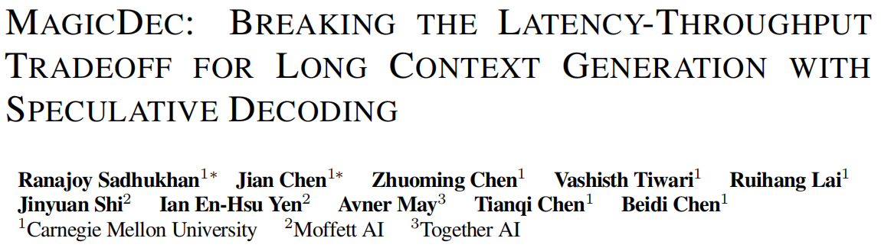
MagicDec
ICLR’25

Slide 3
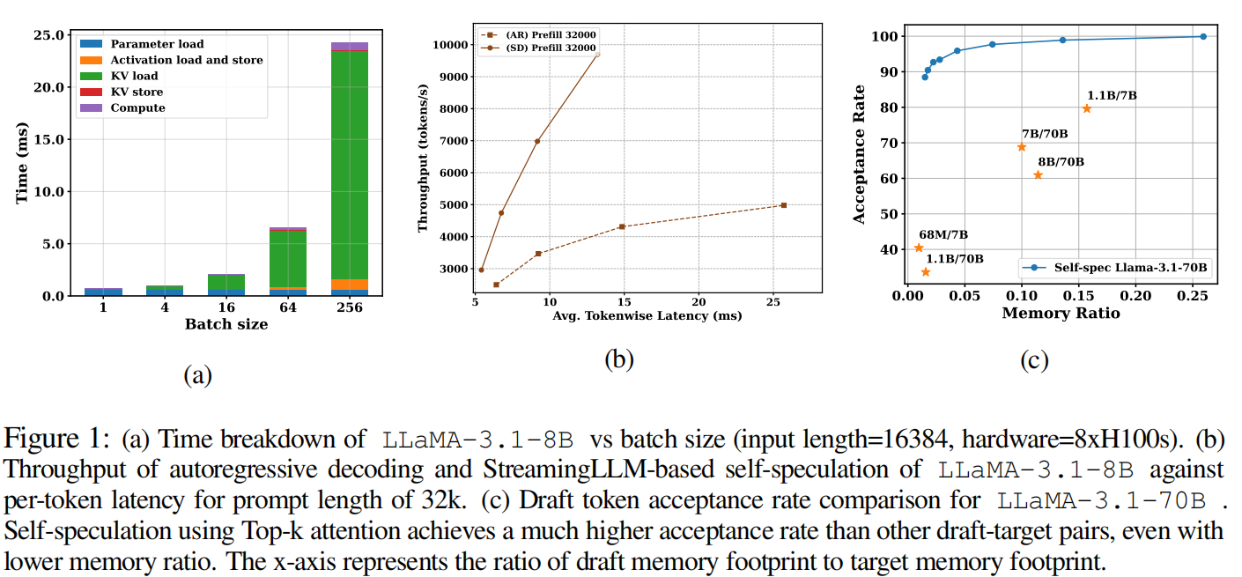
MagicDec

Slide 4
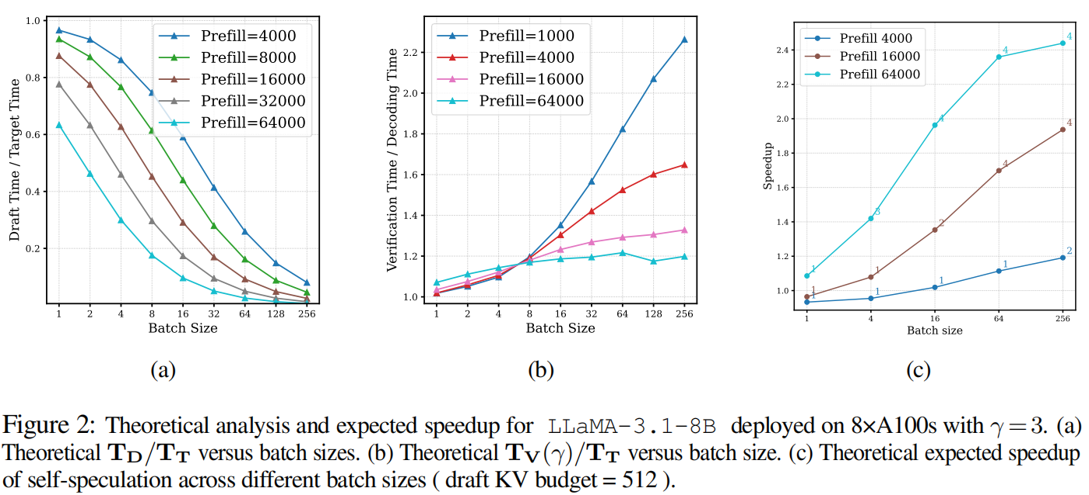
MagicDec

Slide 5
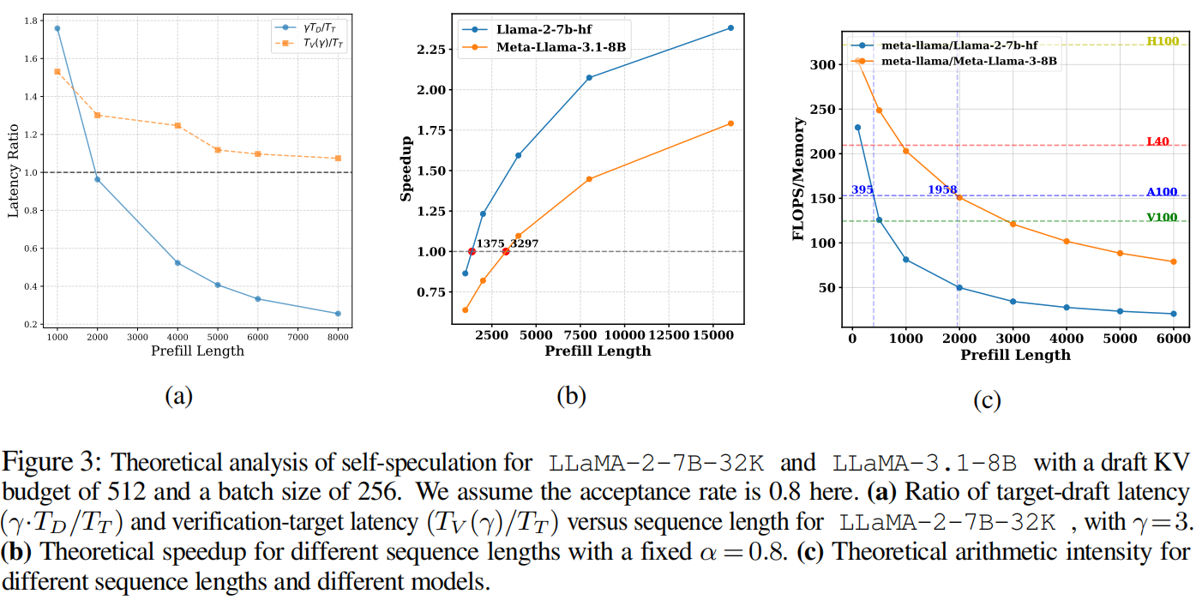
MagicDec

Slide 6
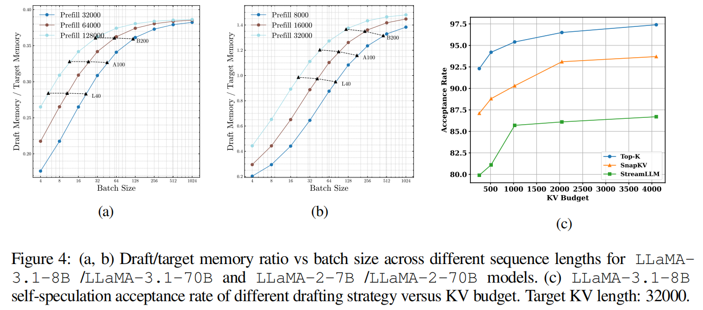
MagicDec

